Slide 1
Category-aware Collaborative Sequential Recommendation
Source: SIGIR '21
Speaker: Po-Jen, Wen
Advisor: Jia-Ling, Koh
Date: 2021/12/07

Slide 2
OUTLINE
Introduction
Method
Experiment
Conclusion

Slide 3
OUTLINE
Introduction
Motivation
Input and output

Slide 4
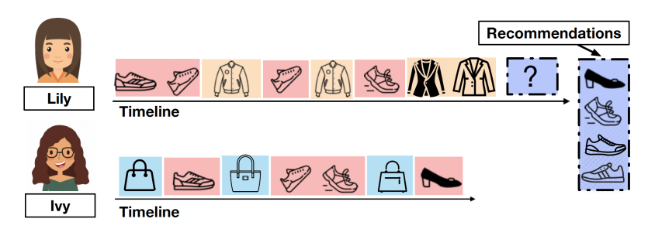
Motivation
Sequential recommendation should be context-aware
under different contexts, the prediction of next action should depend on different subsequences of past actions.
Sequential recommendation is data sparsity
Propose a CategOry-aware COllaborative sequential Recommender (CoCoRec)

Slide 5
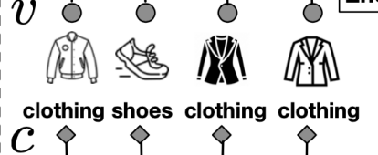
Input & Output
Item and Category recent L subsequence
Input
CoCoRec
Output
Items Sequence
In-category item recent T subsequence

Slide 6
OUTLINE
Method
Overall Framework
In-category Encoder
Context Encoder
Collaboration Module

Slide 7
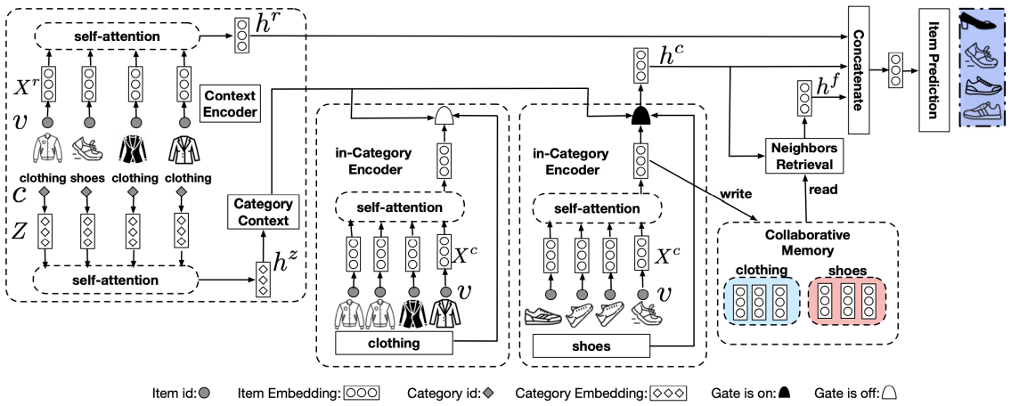
Overall framework of CoCoRec
Context Encoder
Next Item Prediction
In-category Encoder
Collaboration Module

Slide 8
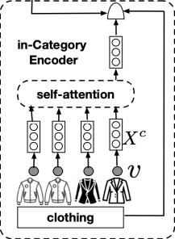
In-Category Encoder
Item embedding layer
Position embedding layer

Slide 9
In-Category Encoder

Slide 10
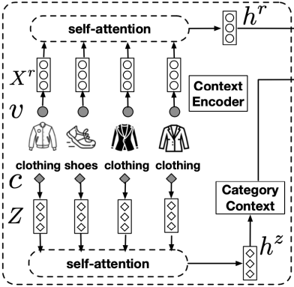
Context Encoder
Item embedding layer
Position embedding layer

Slide 11
Context Encoder
Item embedding layer
Position embedding layer

Slide 12
Context Encoder

Slide 13
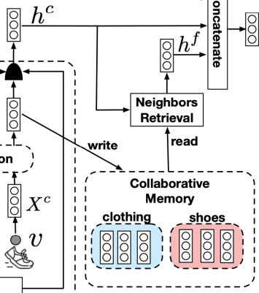
Collaborative Module

Slide 14
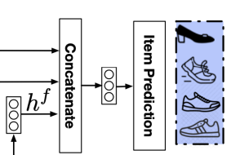
Collaborative Module

Slide 15
Loss function

Slide 16
OUTLINE
Experiment
Datasets
Evaluation Metrics and Baselines
Experiment results

Slide 17
Datasets
Datasets: Taobao 、 BeerAdvocate

Slide 18
Evaluation Metrics and Baselines
Evaluation Metrics:
Recall@K、Mean Reciprocal Rank@K
Baselines:
Heuristic solutions：
GlobalPop、SeqPop
Classical sequential recommendation solutions：
GRU4Rec、BERT4Rec、M3R
Category-aware sequential recommendation solutions：
RNN+MTL、MFGAN
Collaborative learning based sequential recommendation solutions：
CSRM、ICM-SR

Slide 19
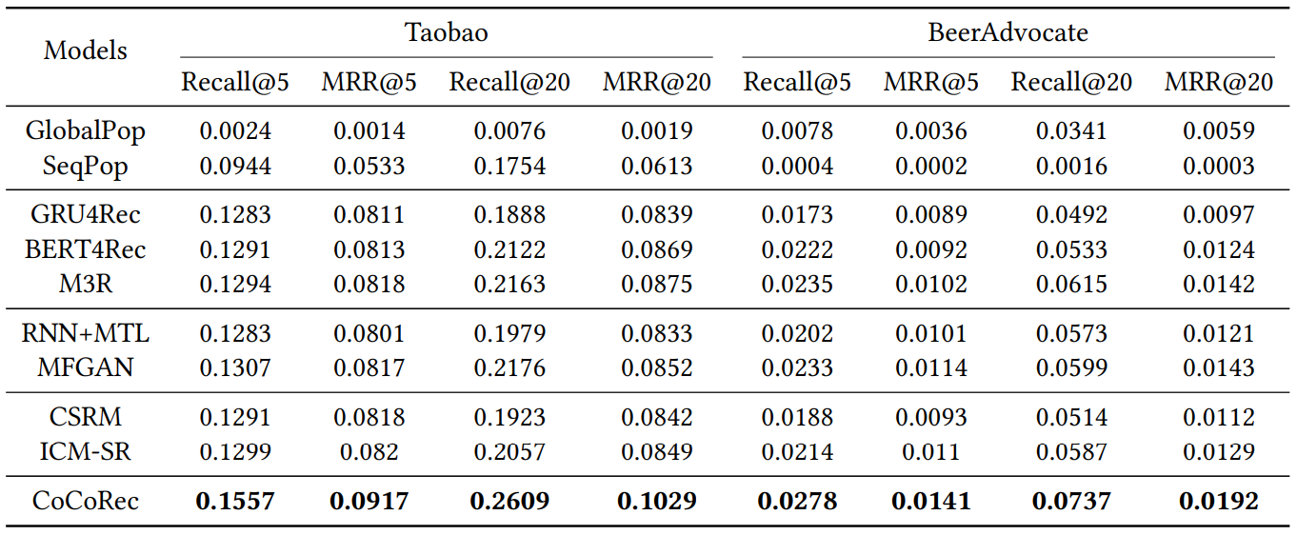
Experiment results

Slide 20
Experiment results

Slide 21
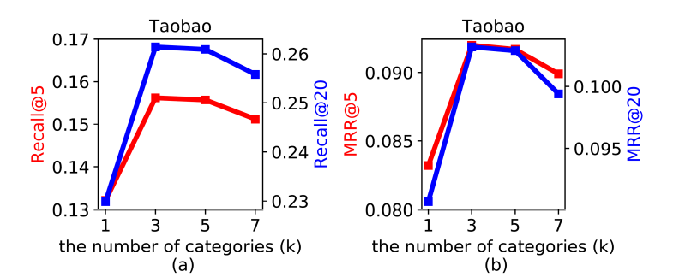
Experiment results
Number of selected categories (𝑘) on Taobao

Slide 22
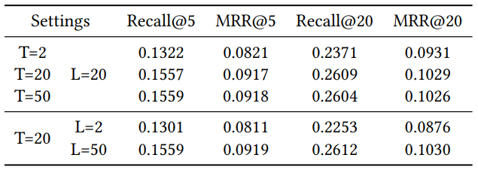
Experiment results
Number of actions in in-category encoder (𝑇 ) and context encoder (𝐿) on Taobao

Slide 23
Experiment results
number of retrieved neighbors on Taobao dataset

Slide 24
Conclusion
CoCoRec to leverage category information to capture the context-aware action dependence for sequential recommendation.
CoCoRec employs a self-attention network to capture item-to-item transition patterns.
A top-𝑘 gating network is employed to predict the category of the next item, so as to activate the in-category preferences for the next item prediction.
CoCoRec models the most recent actions as episodic context, due to their close proximity to the next action.
CoCoRec employs context-aware collaborative learning across users with similar in-category preferences

